Slide 1
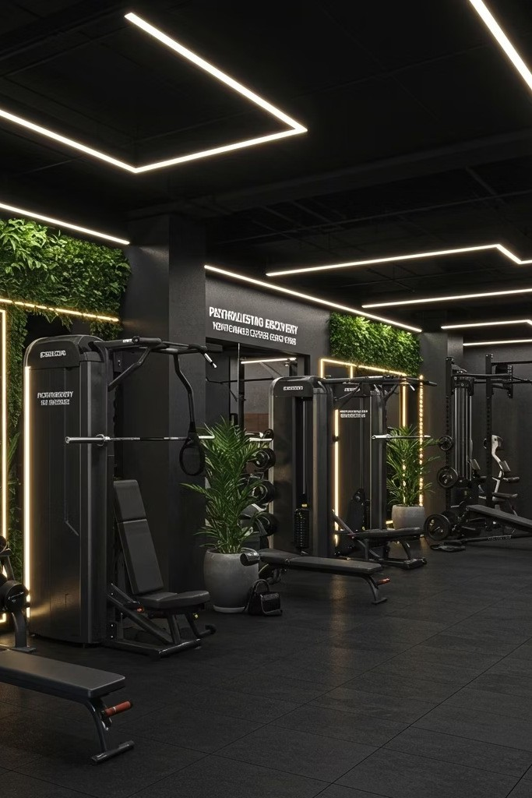
FitLife Gym Website Project
Presented by Waheed Haider Rizvi
Course: B.Tech
Branch: CSE Cyber Security
Roll no: 60

Slide 2
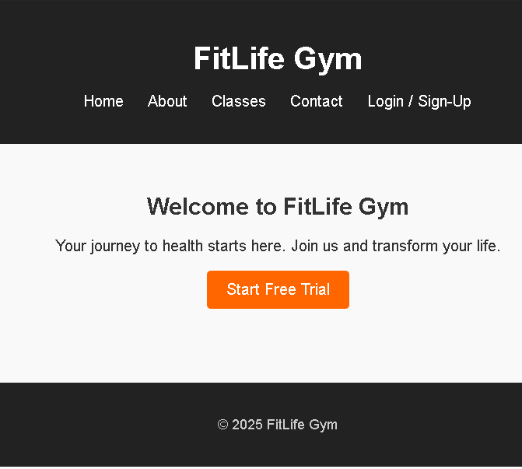
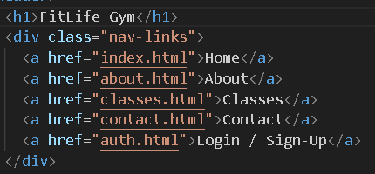
Home Page Architecture
Core Components
The homepage serves as the welcoming gateway to FitLife Gym, featuring a clean, structured layout with HTML elements. The page includes a prominent call-to-action button encouraging visitors to start their fitness journey with a free trial.
header with integrated navigation menu Engaging button for trial sign-ups
Consistent footer with contact information

Slide 3
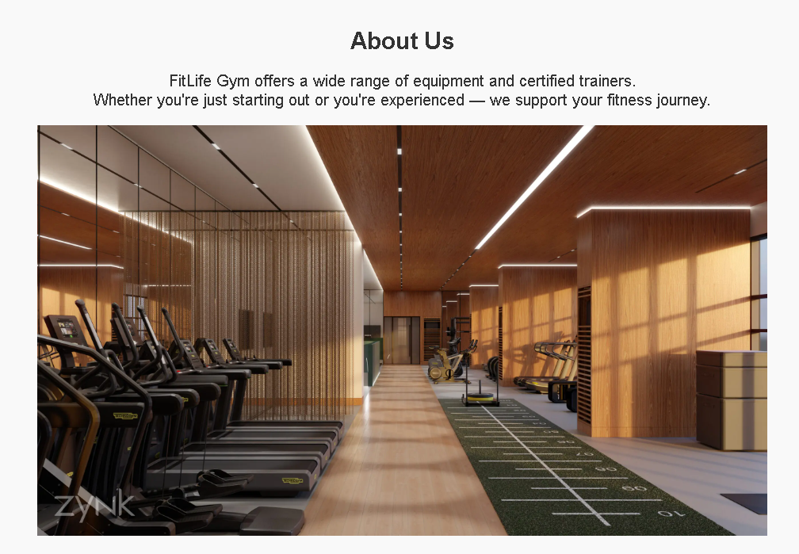
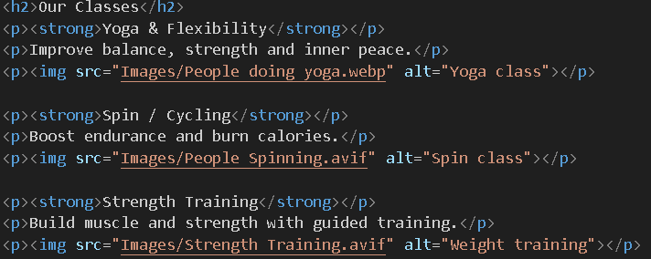
About & Classes Pages
About Us Page
Compelling narrative highlighting FitLife Gym's mission, values, and community focus. Features professional photography showcasing the facility's modern interior and welcoming atmosphere.
Classes Page
Detailed breakdown of three signature programs: Yoga for flexibility and mindfulness, Spin for cardio endurance, and Strength training for building power. Each section pairs descriptive content with inspiring imagery.

Slide 4
Contact Page Structure
Physical Address
Complete street address displayed prominently for visitors planning to visit the facility in person.
Phone Contact
Direct phone line for immediate inquiries, membership questions, and scheduling support.
Email Support
Professional email address for non- urgent communications and detailed inquiries.
The contact page maintains consistency through reused header and footer components, ensuring seamless navigation across the entire website experience.

Slide 5
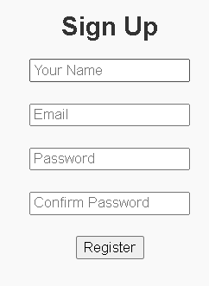
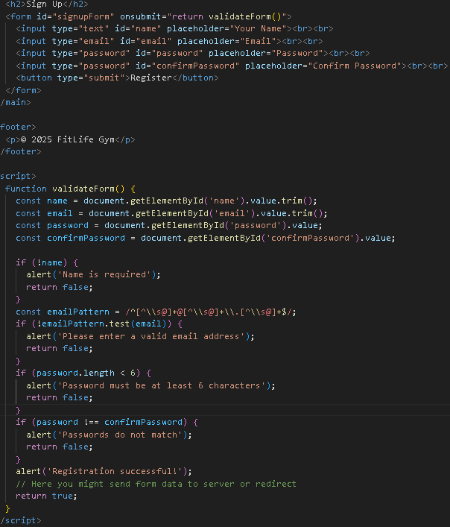
Login & Sign-Up System
Form Fields
Full name input field Email address field Password entry Password confirmation
JavaScript Validations
Name field cannot be empty Email format verification
Minimum 6-character password
Password matching confirmation
Client-side validation ensures data integrity before submission, providing immediate feedback to users and reducing server load while improving the overall user experience.

Slide 6
CSS Styling Framework (style.css)
01
Foundation Reset
Base CSS reset removes browser inconsistencies and establishes consistent font families across all pages.
03
Interactive Navigation
Styled navigation links include hover effects that enhance user interaction and improve usability.
05
Responsive Images
Images scale fluidly across all device sizes, ensuring optimal viewing on desktop, tablet, and mobile.
02
Header Theme
Dark-themed header creates strong visual contrast and professional appearance for the navigation area.
04
Button Styling
Eye-catching orange buttons serve as primary call-to-action elements throughout the site.
06
Footer Design
Cohesive footer styling complements the overall design while providing essential information and links.

Slide 7
THANK YOU

